Slide 1

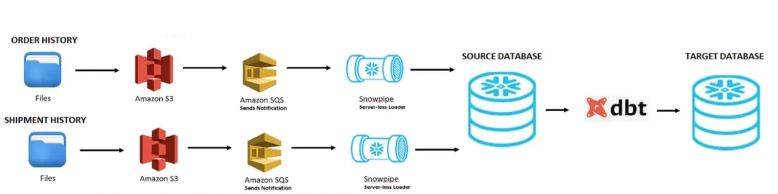
Data Warehouse Development Project Building an Analytics Platform on Snowflake and dbt Presenter: [Put your name] Date: [Current Date]

Slide 2
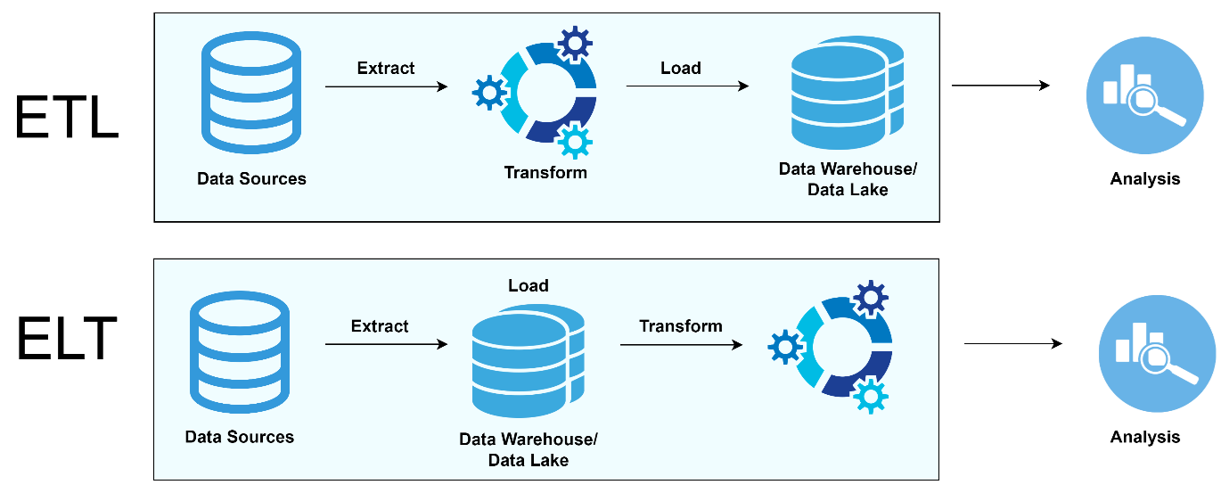
Agenda
Project Overview & Objectives
Data Staging & Loading (E & L)
Data Architecture - Raw Layer
Data Warehouse Design (T - Transformation)
Transformation Pipeline (dbt & CI/CD)
Transformation Results & Validation
Analytics Layer & Use Cases
Summary & Next Steps
Q&A

Slide 3
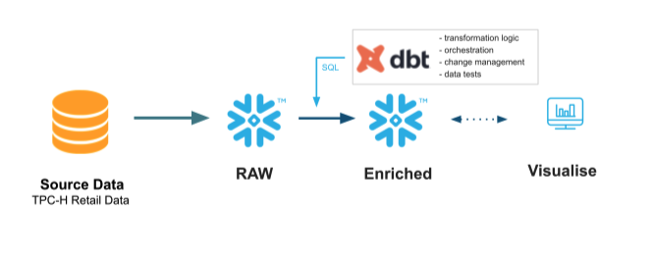
Project Goal: Unified Data for Analytics
Delivering a Kimball-style Star Schema DW
Key Points:
Goal: Establish a robust, scalable, and governed Data Warehouse (DW) to support Sales and Inventory analytics.
Technology Stack: Snowflake (Cloud DW), AWS S3 (Staging), dbt (Transformation), GitHub Actions (CI/CD).
Methodology: ELT (Extract, Load, Transform)—leveraging Snowflake's compute power for transformations using dbt.
Source Data: CSV files ingested from external systems.

Slide 4
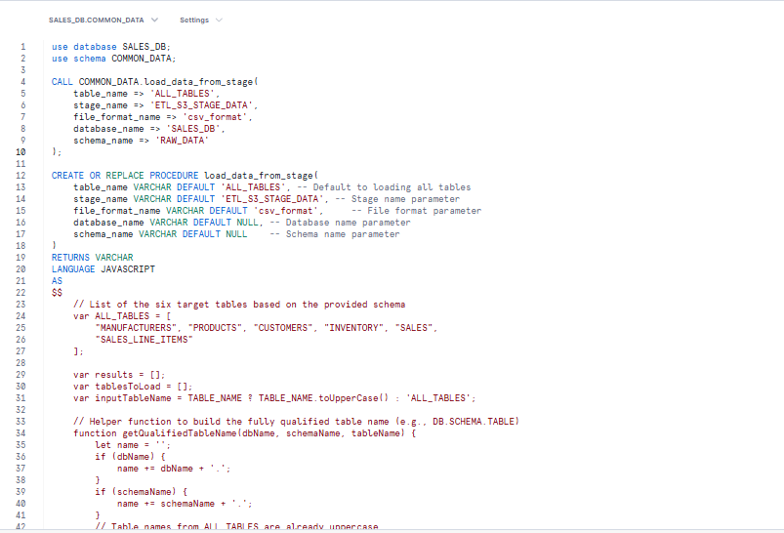
Data Ingestion: AWS S3 to Snowflake
Automating Raw Data Loading
Key Details:
Source Location: All raw CSV files are stored in the designated S3 bucket.
S3 Bucket Path: s3://etl-data-csv-s3-bucket
Snowflake Integration: An External Stage is defined in Snowflake's COMMON_DATA schema to read directly from S3. (See raw_tbl_def.sql for DDL)
Loading Mechanism: A JavaScript-based Snowflake Stored Procedure handles the bulk COPY INTO operation.
Notes:
Speaker Notes:
The raw data tables are first defined in the RAW_DATA schema.
The stored procedure is designed to be flexible: it can load all six tables or a single specified table, referencing the S3 stage directly.
The procedure ensures all data lands in the RAW_DATA schema, ready for the next transformation layer.

Slide 5
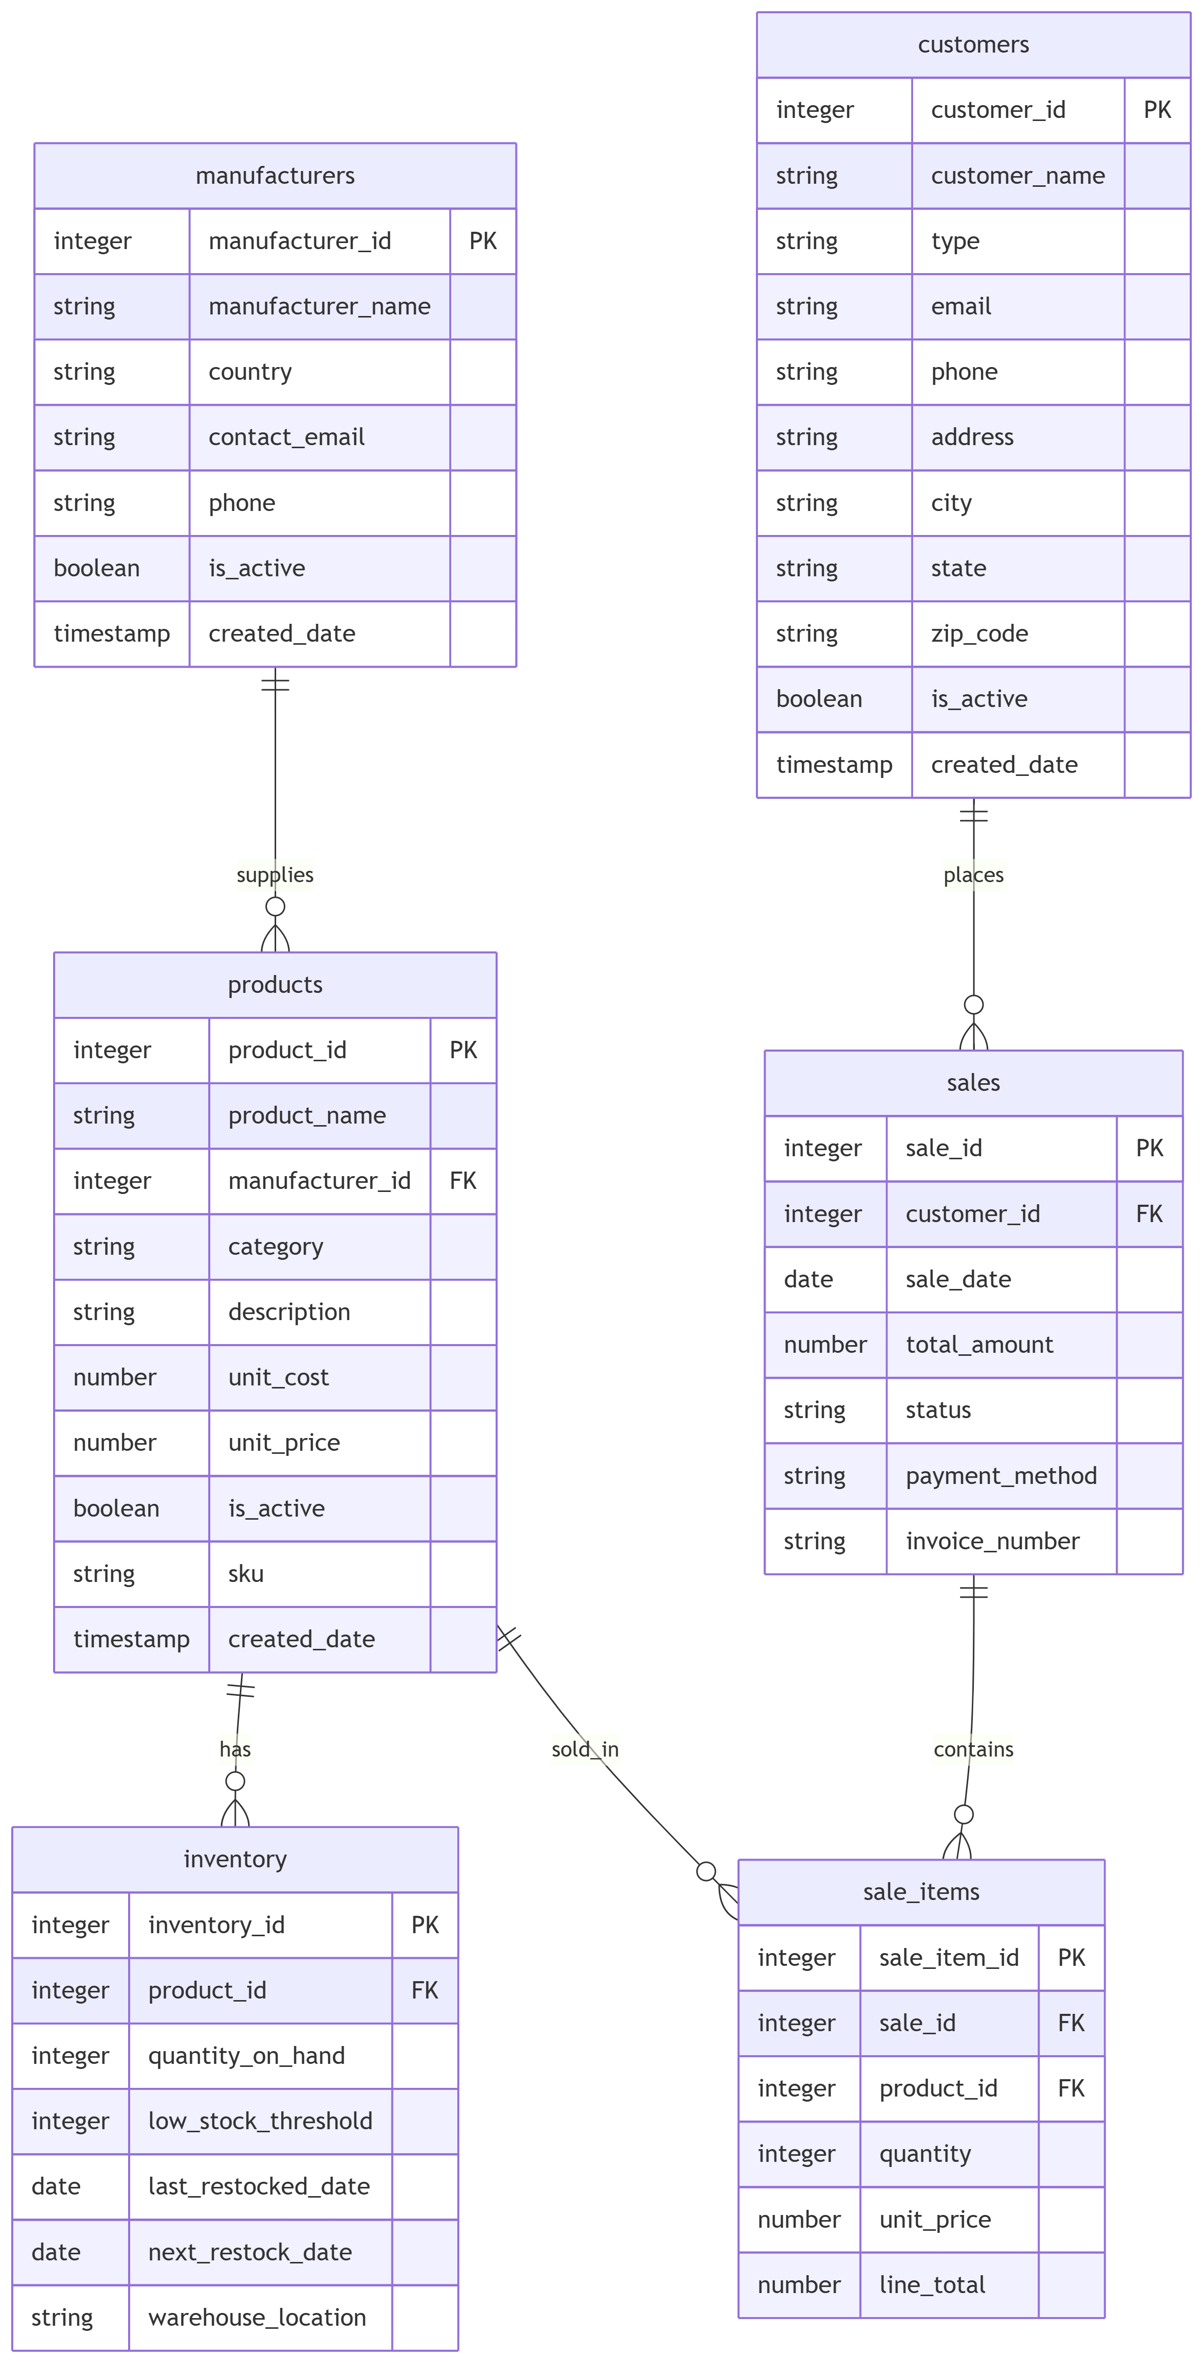
Source & Raw Data Model
Foundation of the Data Warehouse
Key Entities (RAW_DATA Schema):
manufacturers
products
customers
inventory
sales
sales_line_items
Notes:
Speaker Notes:
This diagram reflects the relational structure of the raw source data (OLTP style).
The goal of the next step (Transformation) is to convert this structure into a simplified Star Schema that is optimized for analytical queries.

Slide 6
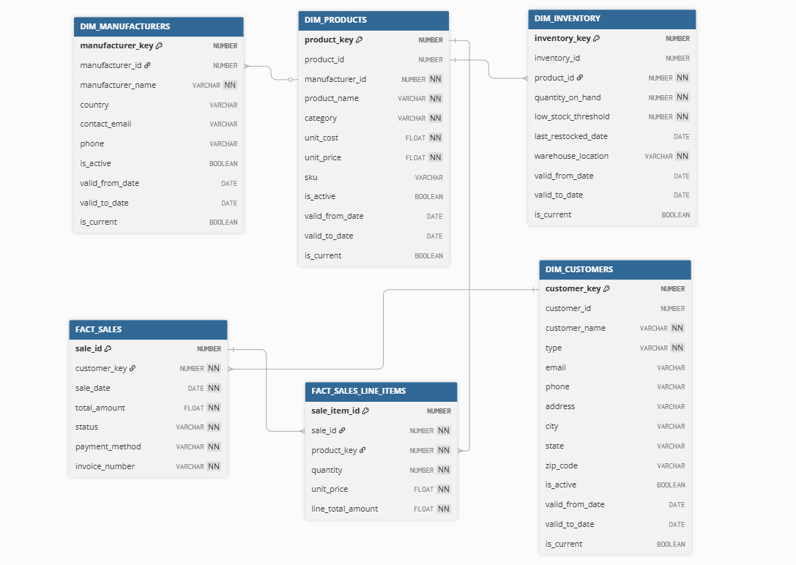
Star Schema Design
Converting OLTP to DW using dbt
Key Transformation Concepts:
Schema: TRANSFORM_DATA
Dimension Tables (SCD Type 1/2 Ready):
DIM_MANUFACTURERS, DIM_PRODUCTS, DIM_CUSTOMERS, DIM_INVENTORY
Fact Tables:
FACT_SALES, FACT_SALES_LINE_ITEMS
Notes:
Includes explicit Surrogate Keys (*_key), and SCD Type 2 fields (valid_from_date, valid_to_date, is_current).
Fact tables link to the new Dimension tables via their Surrogate Keys (customer_key, product_key).

Slide 7
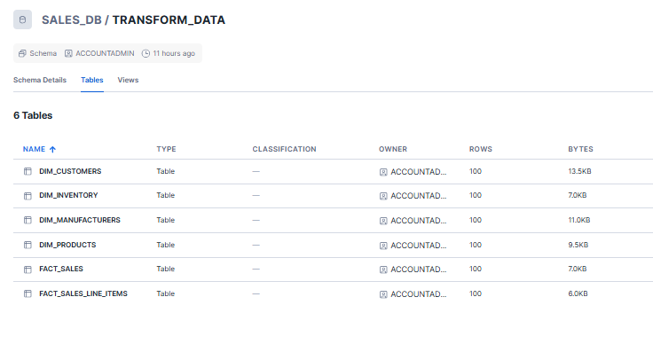
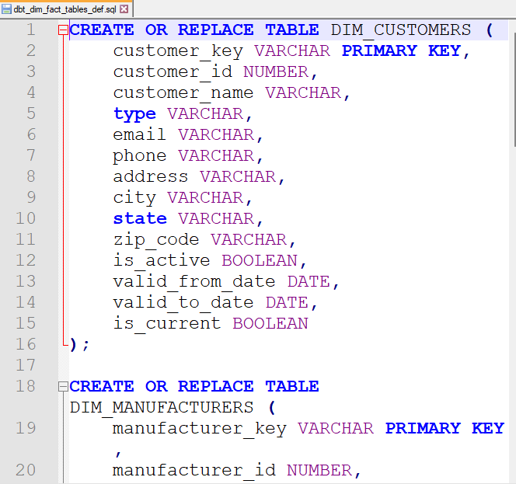
Star Schema Design
Converting OLTP to DW using dbt

Slide 8
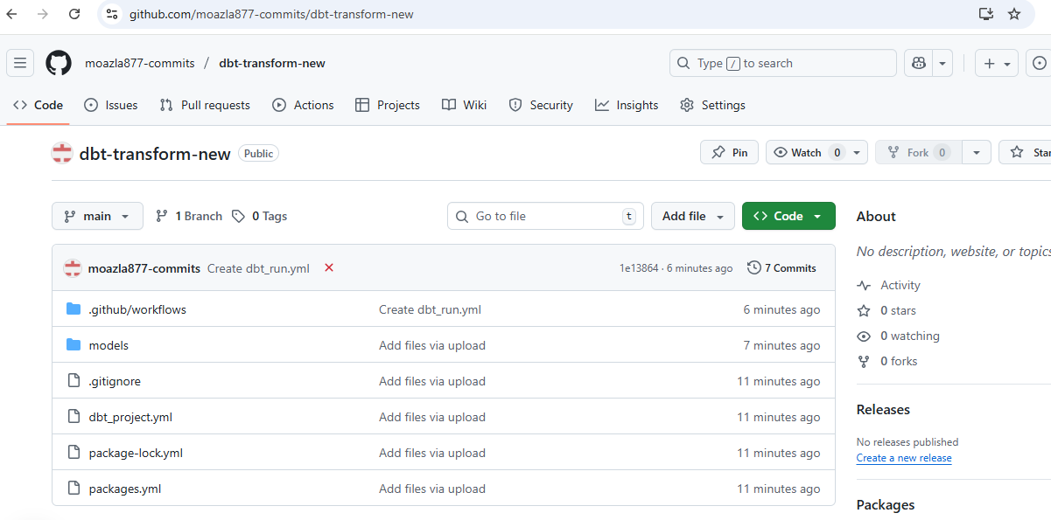
Transformation Automation with dbt
Git-Native Data Modeling and CI/CD
Pipeline Components:
dbt Project: Hosted in a GitHub Repository (dbt-transform).
Configuration: Snowflake credentials and environment variables are secured using GitHub Repository Secrets.
CI/CD: GitHub Actions triggers dbt run to deploy changes automatically upon commits/merges.
Notes:
Speaker Notes:
dbt provides governance, version control, and testing for all transformation logic.
The use of GitHub Secrets ensures secure handling of production credentials for Snowflake access.

Slide 9
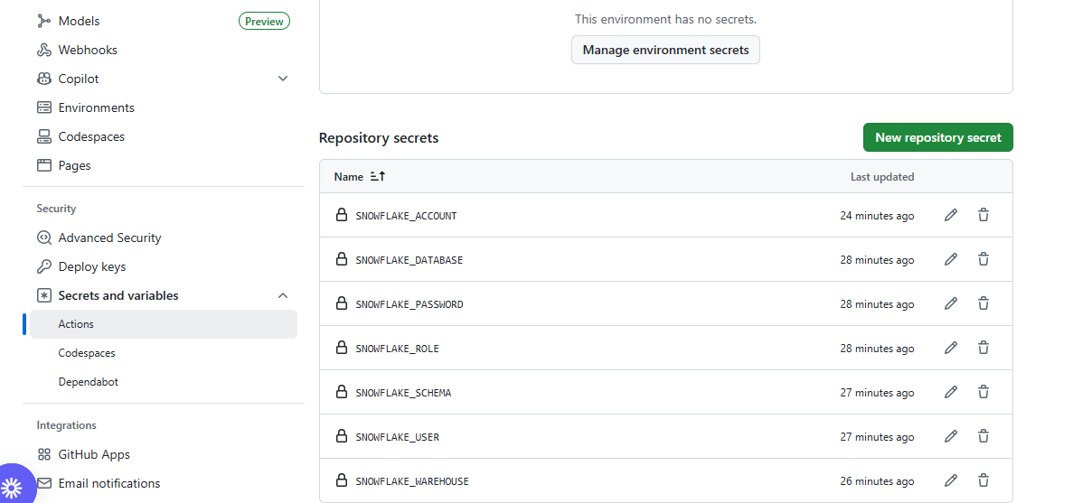
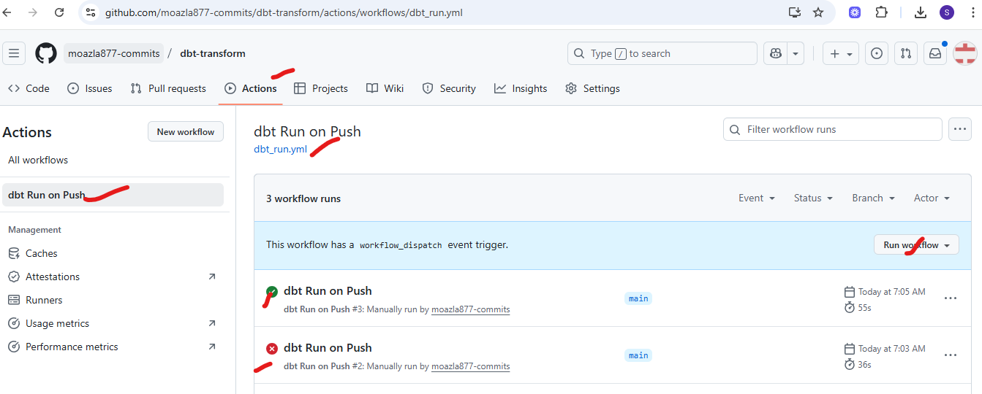
Transformation Automation with dbt
Git-Native Data Modeling and CI/CD

Slide 10
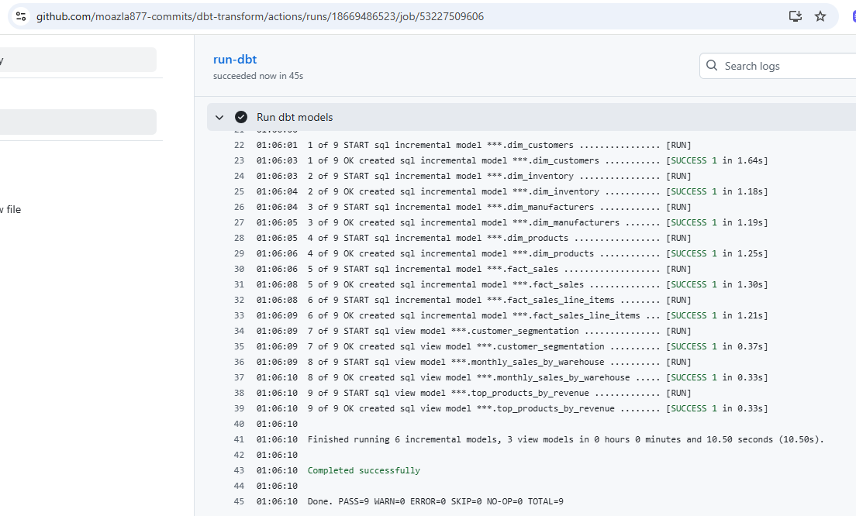
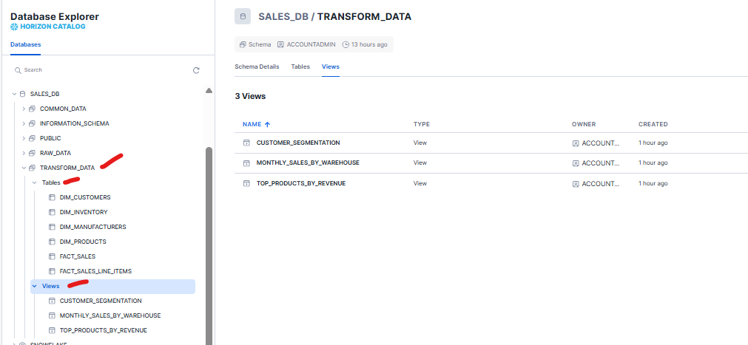
Successful Data Transformation
Incrementally Building the Star Schema
Validation Proof:
dbt Run Log: Successful execution of 6 incremental models (DIM/FACT tables) and 3 analytic views.
Target Tables: Confirmation that the 6 Dimension and Fact tables were created in the TRANSFORM_DATA schema.
Notes:
Speaker Notes:
This validates the pipeline is functioning end-to-end, from raw data ingestion to staged, modeled data.
The incremental nature of the models ensures efficiency during subsequent runs.

Slide 11
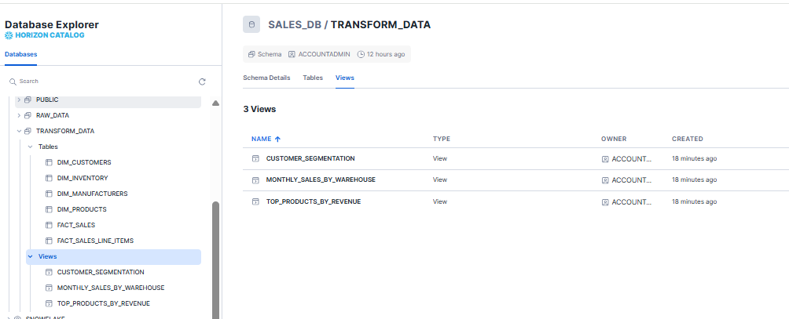
Enabling Business Intelligence
Production of Key Analytical Views
Analytics Views (Built on top of DIM/FACT tables):
CUSTOMER_SEGMENTATION
MONTHLY_SALES_BY_WAREHOUSE
TOP_PRODUCTS_BY_REVENUE
Key Business Value:
Self-Service BI: These views simplify complex joins, making data consumption easy for analysts and BI tools.
Performance: Queries hit the optimized Star Schema, ensuring fast report generation.
Metrics Consistency: Centralizing logic in dbt and these final views guarantees consistent definition of core business metrics.

Slide 12
Enabling Business Intelligence & Value
Real-World Use Cases for the Modeled Data
Key Business Use Cases:
Sales Performance Tracking:
Objective: Analyze trends, identify top-performing regions, and measure sales cycle efficiency.
Query Example: Calculate Monthly Sales Revenue by Region and Customer Type.
Customer Segmentation & Targeting:
Objective: Group customers based on purchasing behavior to optimize marketing campaigns.
Query Example: Identify the top 10% of customers by lifetime spend (LTV) or by recent purchase frequency.
Inventory Optimization & Forecasting:
Objective: Reduce stockouts and minimize carrying costs.
Query Example: Determine which products in which warehouses are currently below the lowstock threshold and require reorder.
Product Profitability Analysis:
Objective: Evaluate the margin and performance of product categories and individual SKUs.
Query Example: Calculate the gross profit margin (Unit Price - Unit Cost) by Manufacturer and Product Category.
Notes:
Speaker Notes:
The Star Schema enables these complex joins to run quickly.
By creating views like CUSTOMER_SEGMENTATION, we provide pre-aggregated, easy-to-use data for the BI team, speeding up report development significantly.

Slide 13
Project Summary
Completed Scope & Future Development
Accomplished:
✅ Established Snowflake environment (SALES_DB, RAW_DATA, TRANSFORM_DATA schemas).
✅ Implemented secure S3 Stage and automated COPY INTO procedure.
✅ Successfully modeled and deployed a Star Schema (6 DIM/FACT tables) using dbt.
✅ Created 3 core analytical views for BI consumption.
Next Steps:
Implement full SCD Type 2 logic in dbt dimension models.
Integrate data quality checks (dbt tests) across all models.
Connect BI tool (e.g., Tableau, Power BI) to the analytical views.
Implement task scheduling for automated end-to-end pipeline execution.

Slide 14
Project Challenges & Mitigation
Navigating Data Quality, Transformation, and Performance
Key Challenges and Solutions:
Inconsistent Source Data (S3 CSVs):
Challenge: Raw CSV files often contained mixed data types, unexpected NULLs, or formatting errors which could halt the COPY INTO process.
Solution: Configured the Snowflake File Format with options like EMPTY_FIELD_AS_NULL = TRUE and used the ON_ERROR = ABORT_STATEMENT' clause during staging. For dbt transformation, we implemented TRY_CAST functions to handle unexpected non-numeric data gracefully.
Complexity of SCD Implementation:
Challenge: Managing Slowly Changing Dimensions (SCD Type 2) for tables like DIM_CUSTOMERS required complex update logic to track historical changes without relying on external tools.
Solution: Leveraged dbt's incremental models and specific SQL logic to compare new vs. old records, setting valid_to_date and is_current flags accurately within Snowflake.

Slide 15
Project Challenges & Mitigation
Navigating Data Quality, Transformation, and Performance
Key Challenges and Solutions:
Snowflake Cost and Performance:
Challenge: Running full table transformations on large data sets resulted in high query costs and long runtimes.
Solution: Prioritized incremental materialization for all fact and dimension tables where appropriate. We also established a dedicated, rightsized Snowflake Virtual Warehouse for the dbt job to manage performance and cost visibility.
CI/CD Security and Stability:
Challenge: Safely storing and injecting highly sensitive Snowflake credentials into the GitHub Actions workflow.
Solution: Stored all sensitive information (keys, passwords, account IDs) exclusively in GitHub Repository Secrets (Visual: github_repo_secrets.png) which are masked in logs and securely passed as environment variables to the dbt execution environment.

Slide 16
Thank You
Questions and Discussion
GitHub Repo URLs:
https://github.com/moazla877-commits/data-warehouse-scripts
https://github.com/moazla877-commits/dbt-transform-new

